Slide 1
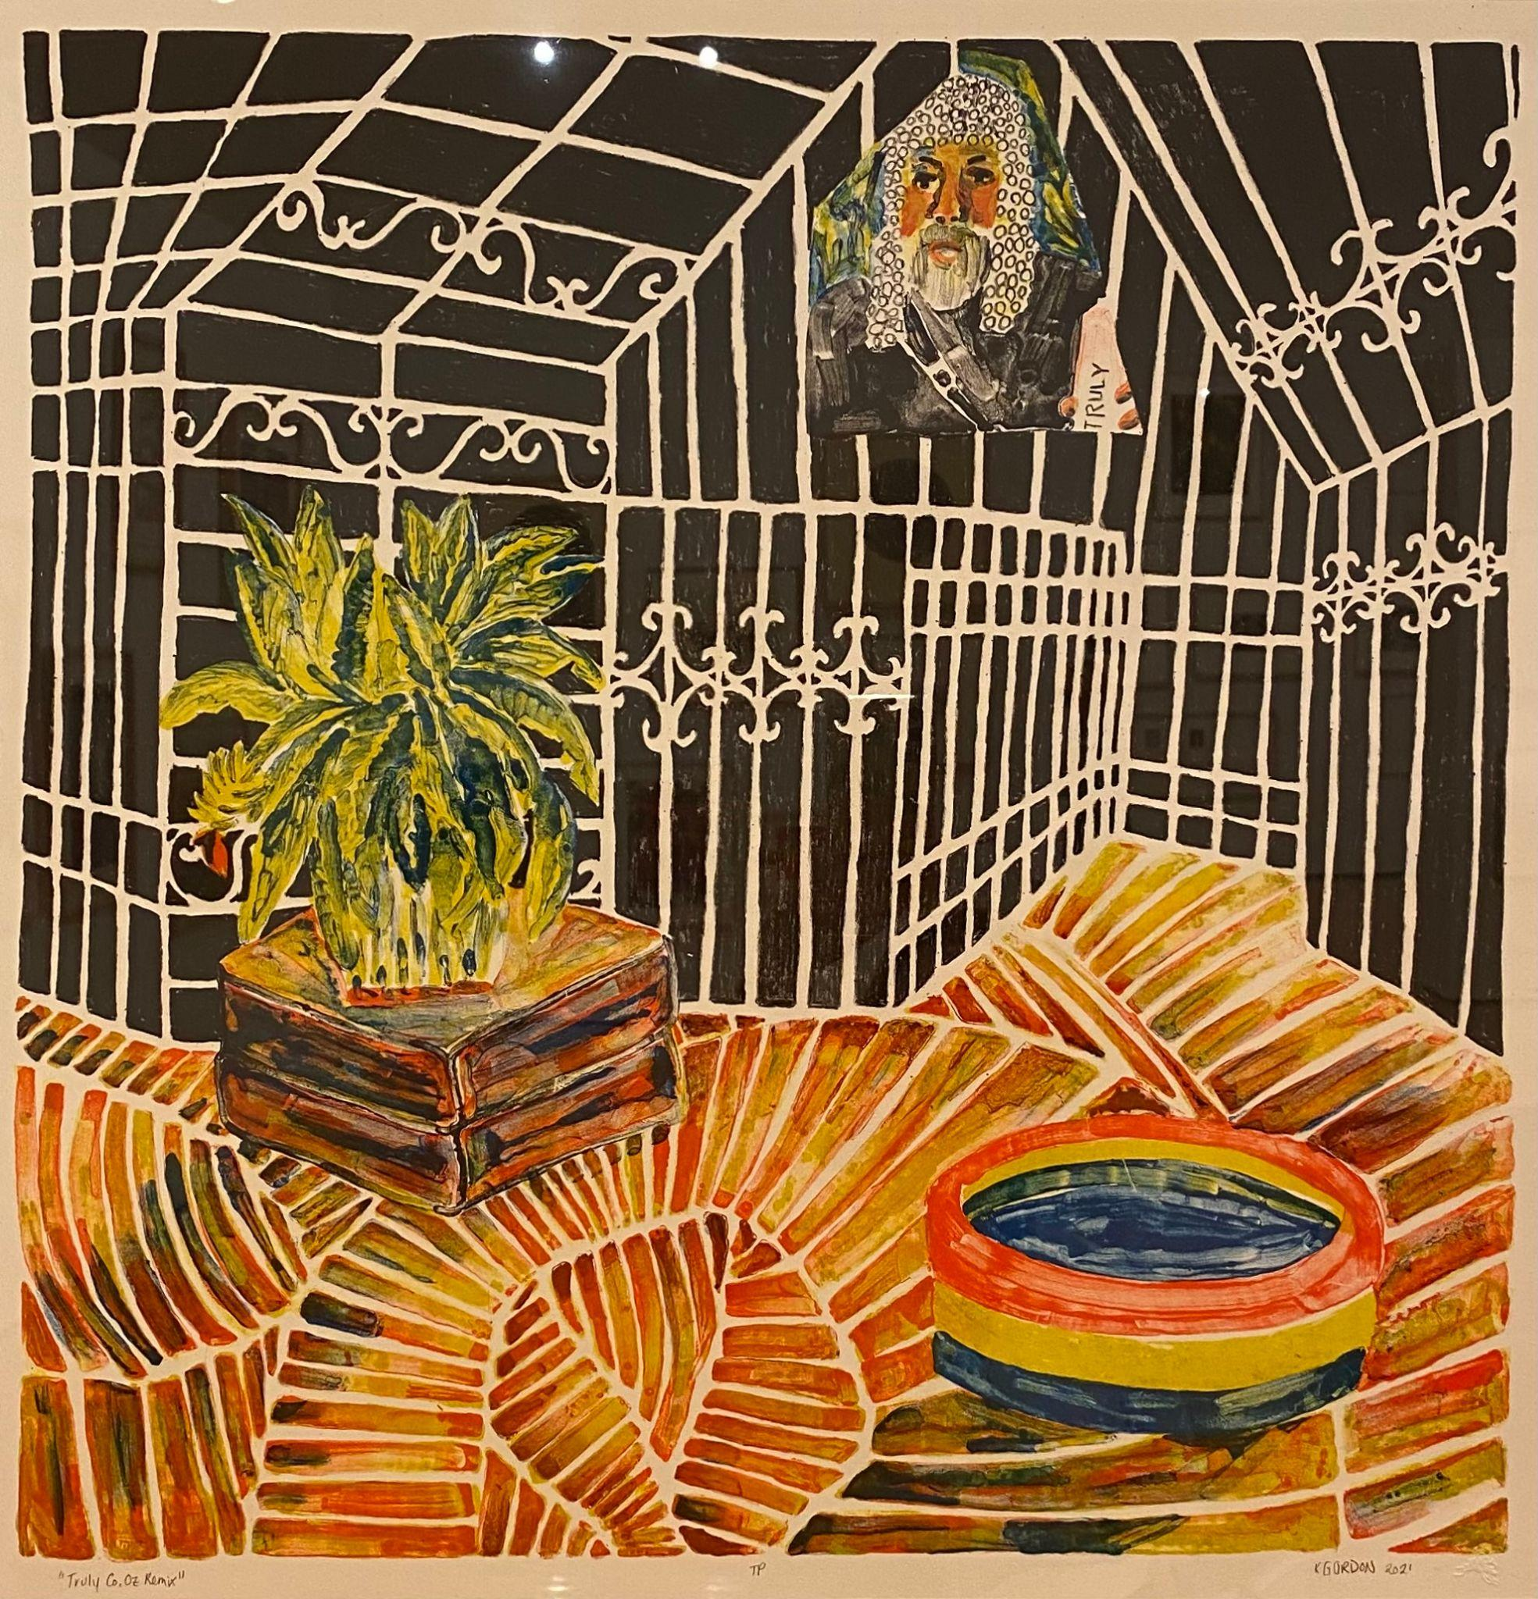

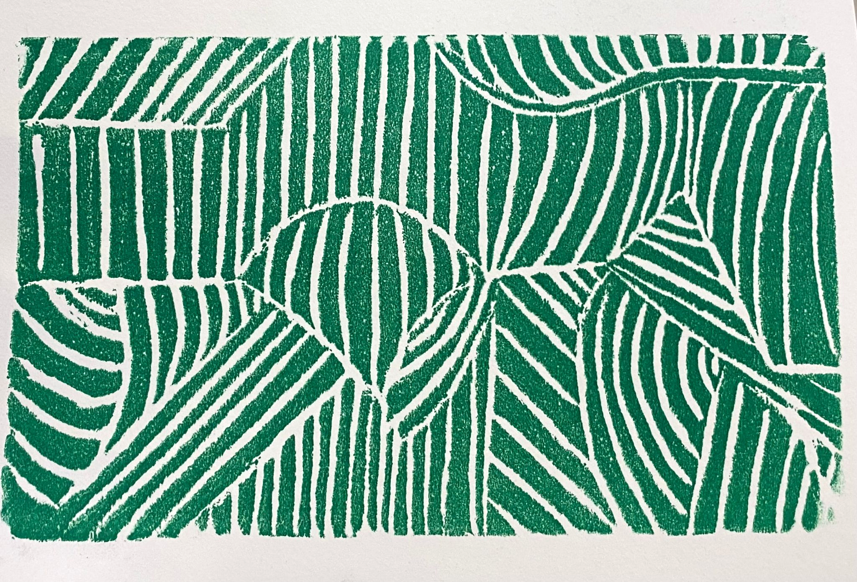
Marais Press Exhibition
Lesson Plan
Distorted Perspective on Styrofoam/Linocut Inspired by Kate Gordon
Created by: Carley Dupré
UL Art Education, Fall 2021

Slide 2
Kate Gordon, American
Truly Co. Oz Remix, Trial Proof
2021
Lithograph
Framed: H-29 W-28 1/2 inches
Marais Press Print Collection
2021.08.10
Photo by Jessica Harrington Photography

Slide 3
Big Ideas and Connections
Gordon describes her work as a “fever dream” in the way that her distortions look familiar, but warped in a way to make the viewer feel uneasy. She uses line in her pieces to bend and twist the viewer’s perception of depth and direction in the piece. She manipulates this element by shifting the size, shape, and direction of line. Up close, the viewer will notice smaller, thinner lines. Farther back, they will notice larger, thicker lines for example.

Slide 4
Big Ideas and Connections
How does Gordon manipulate line to create perspective?
How does Gordon distort the perspective?
How does perspective distortion affect the piece?

Slide 5
Brief Overview
This lesson plan explores line and creating distorted perspective and facilitates students' understanding of styrofoam etching and/or linocut printmaking process.

Slide 6
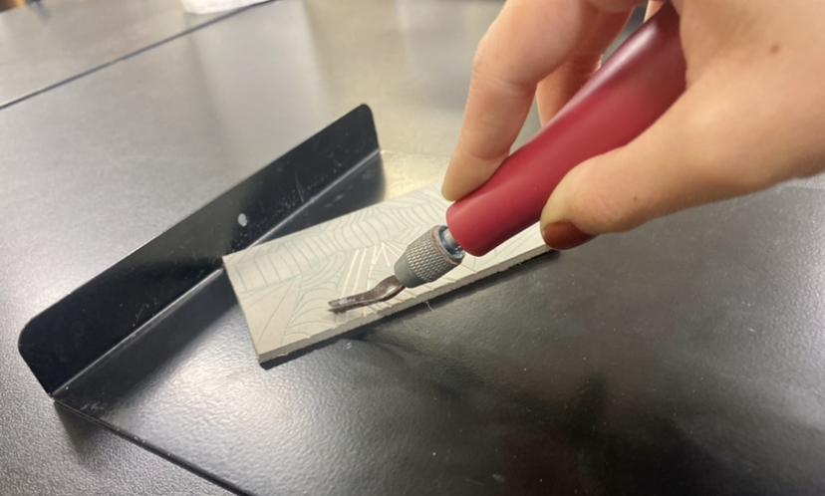
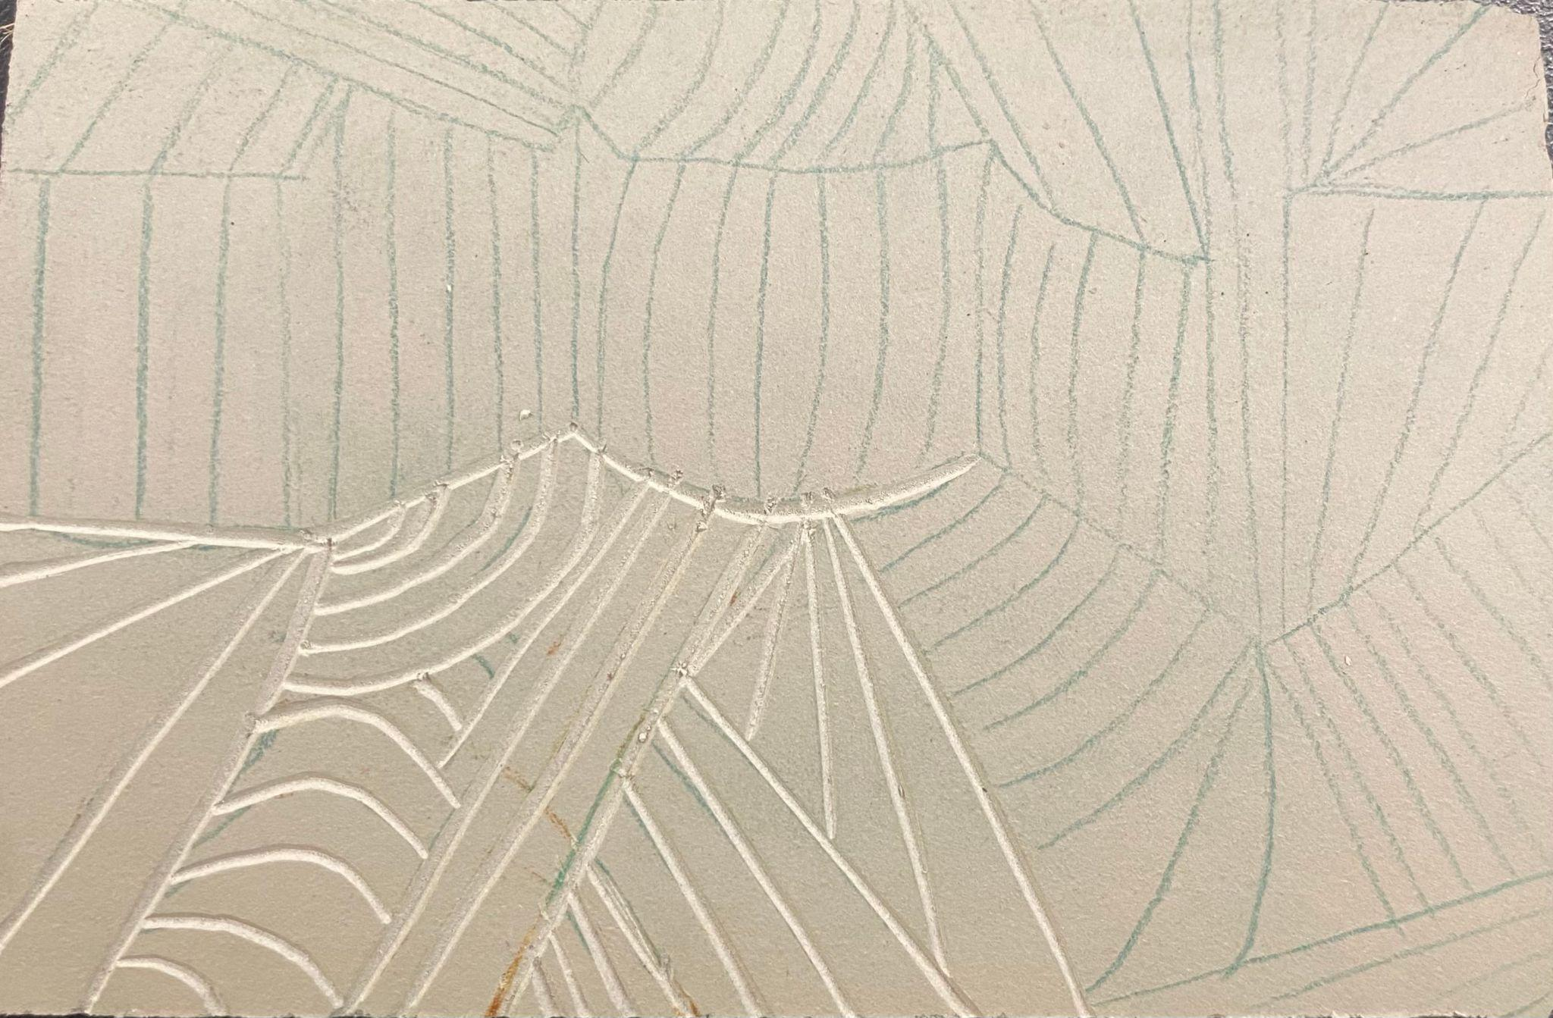
Process (Linoleum option)
Begin carving - tips for tool handling:
Place handle in palm with firm grip
Hold tool about 45 degrees to the linoleum
Always cut AWAY from the body!
Carve with even pressure throughout
Carving doesn’t need to be too deep, just deep enough to not be printed when ink is rolled on the plate.

Slide 7
Brief Overview
Truly Co. Oz Remix shows perspective distortion done in an enclosed environment.
Students will be making an abstract landscape with a horizon line; however, it may also resemble being enclosed.

Slide 8
Objectives
Students will be able to:
Manipulate lines to create perspective, and distort it.
Etch into Styrofoam (or carve into Linoleum)
Understand how to create consistency in an edition.

Slide 9
Standards
Creating:
students will understand the tradition of perspective, and break the tradition with manipulation of line to become distorted.
Generate a unique composition
Presenting:
Students will present their finished work
Connecting:
Students will interpret intent behind their abstract artwork

Slide 10
Materials List:
Option 1 | Option 2
Styrofoam | Linoleum
Dull Pencil | Carving tools with various sized tips
 | Linoleum Plate Holder
Paper -- one for registration, and one to transfer ink onto.
Tracing Paper
Tape
Block Ink
Sheet of plexiglass
Brayer
Large Spoon

Slide 11
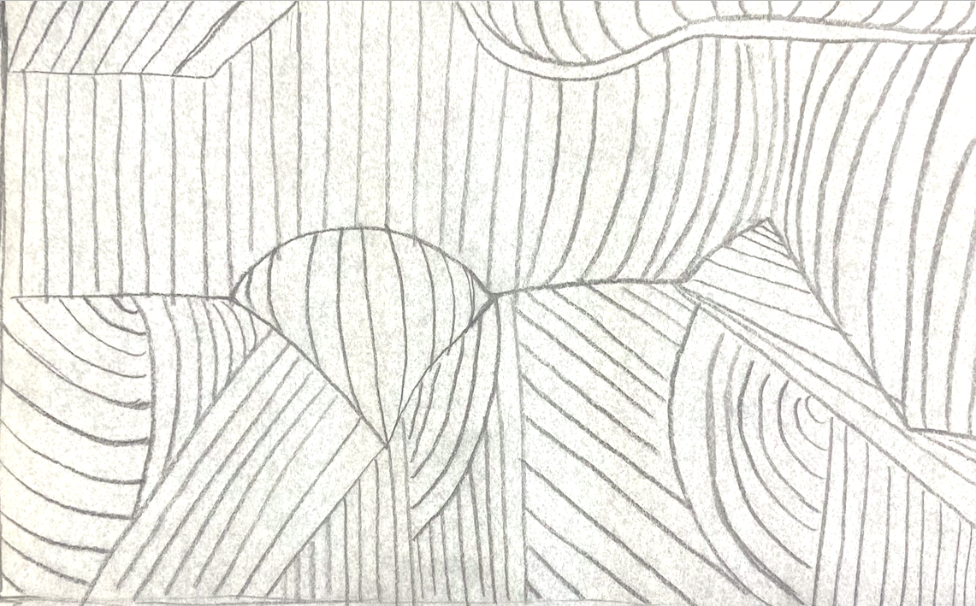
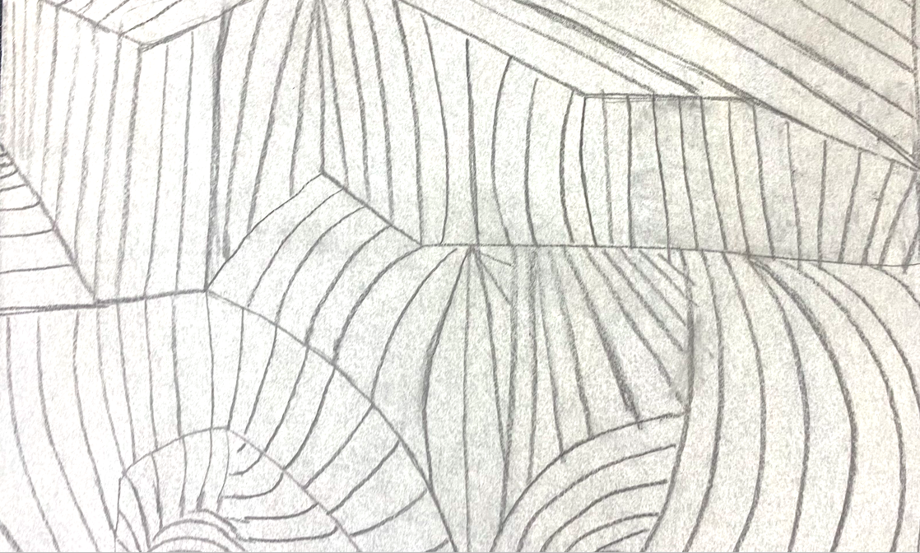
Process
Create 4 compositions of an abstract landscape displaying distorted perspective with a horizon line.
  Measure out dimension of the plate onto tracing paper
  Draw compositions directly onto tracing paper
Facilitate mini-critiques with small groups, discussing which compositions to choose

Slide 12
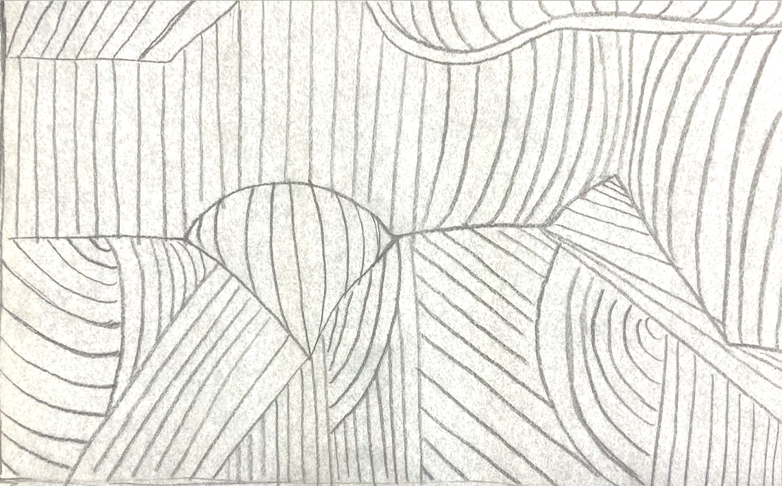
Process
2. Choose one composition from the drawings on the transparency paper.
3. Flip transfer paper over so graphite side is facing the plate.
a. Draw over the paper, either filling up the whole page, or following the the lines made so that the drawing is transferred onto the styrofoam or linoleum.
**It will look backwards, but when printed, it’ll be flipped back to how originally sketched

Slide 13
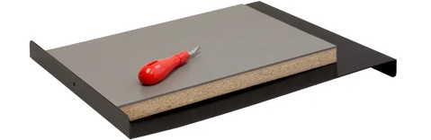
Process (Linoleum option)
4. Set up to carving space
Place lino plate onto the holder, placing the bottom facing lip on edge of the table.
Slide the plate up so it’s against the top of the holder.

Slide 14
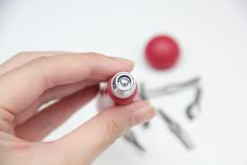
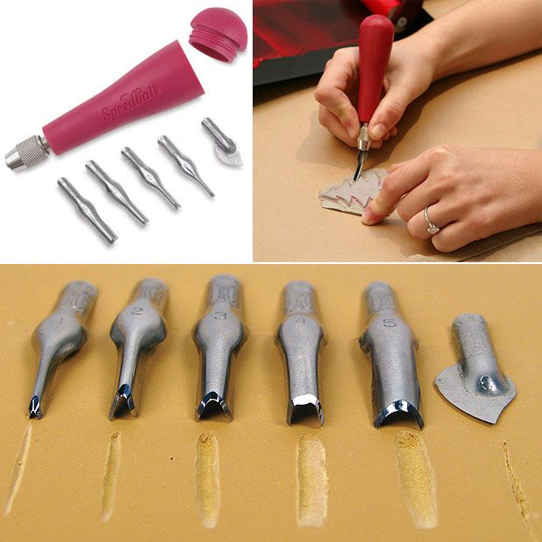
Process (Linoleum option)
5. To assemble the carving tool:
Unscrew the bottom of the handle to view the various carving tips. Choose one to begin with.
Place the rest of the tips back in handle.
Slightly unscrew tip, and notice a gap between 2 pieces inside the tip.
Insert the chosen tool, placing the curved edge in line with the gap.
Screw tip until tightened to not move around.

Slide 15
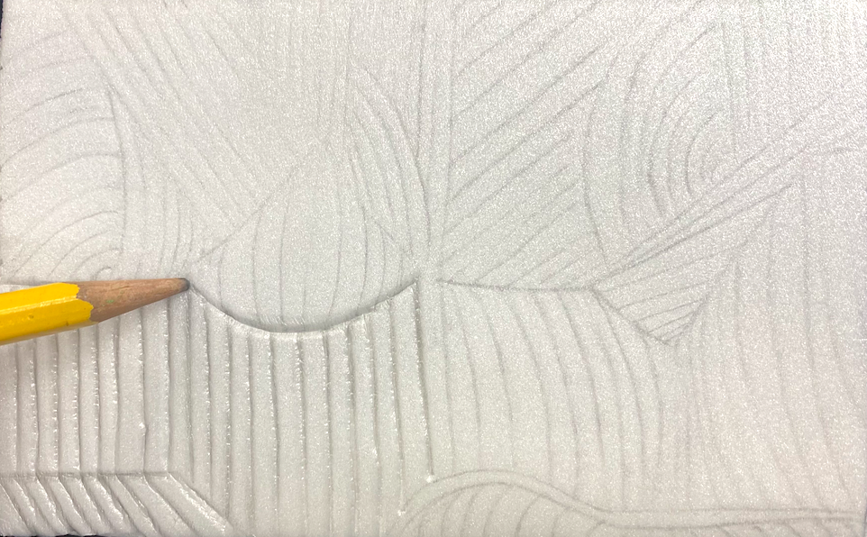
Process (Styrofoam option)
7. Begin etching different makings into the extra sheet of styrofoam
Lightly go over the same line a few times to make an indention
If pressing too hard or too quickly, some chunks of styrofoam could accidentally be scraped off making the lines look jagged.

Slide 16
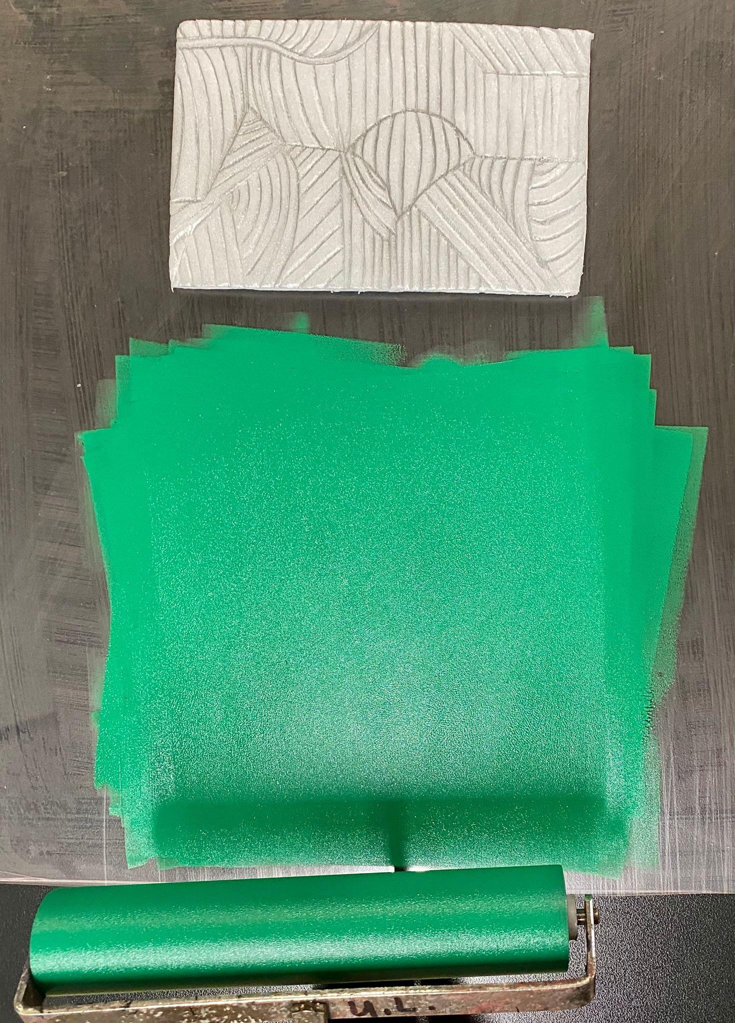
Process
8. Apply a small amount of ink to the inkpad, and begin rolling it out with a brayer to make an even layer of ink.
9. To charge the brayer, roll it in an upward motion, or to either the right or left of the inkpad.
- It is ready for charging once the ink begins to be textured
- Roll it a few times in those directions to ensure enough ink is applied.

Slide 17
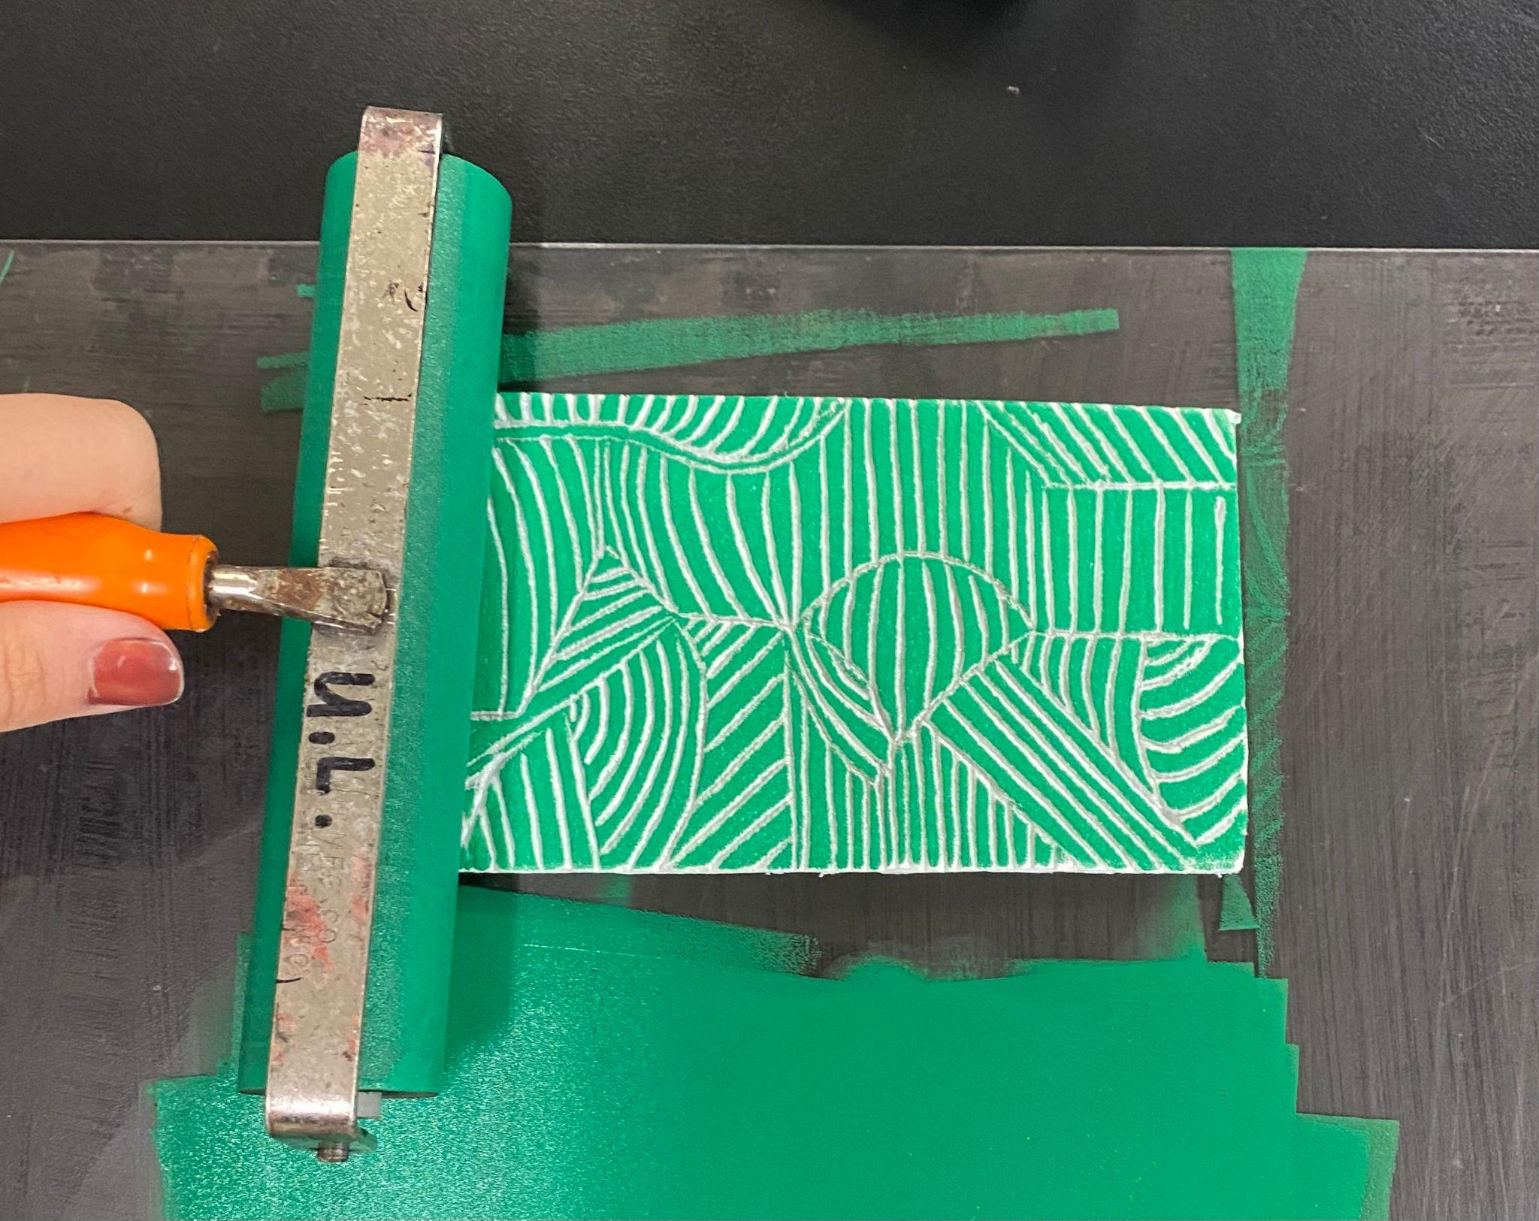
Process
10. Roll the brayer directly onto the plate, in the same motions as on the inkpad
- Continue charging and applying ink until whole plate has an even amount. Be sure to not apply too much ink.
- Do this step on a plexiglass surface or on a napkin as to not get ink on the table!

Slide 18
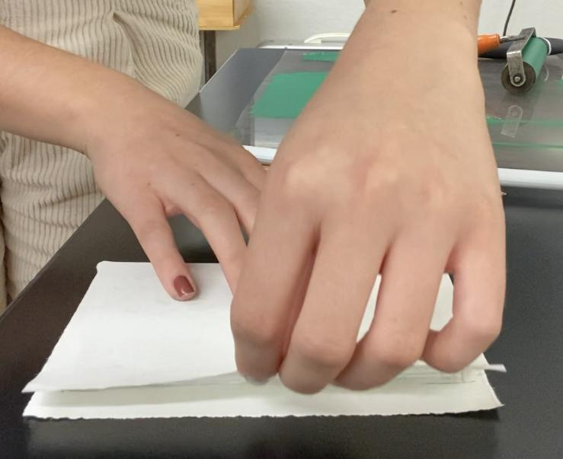
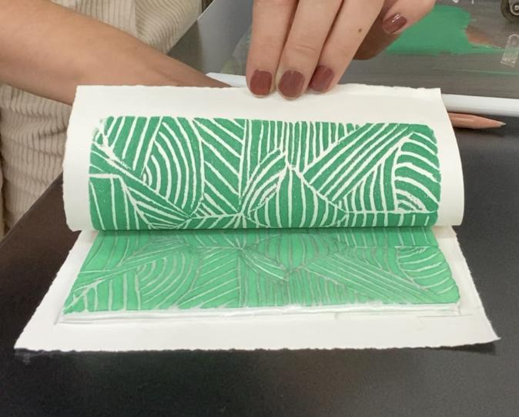
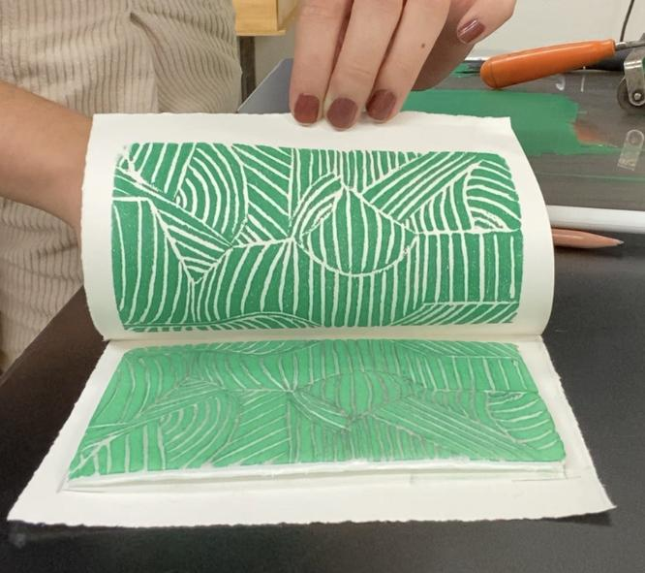
Process
11. Place one paper down, and the plate centered on top facing up.
Create a registration for the plate.
12. Place another paper of the same size on top of the plate, lining it up with the paper that’s underneath it.

Slide 19
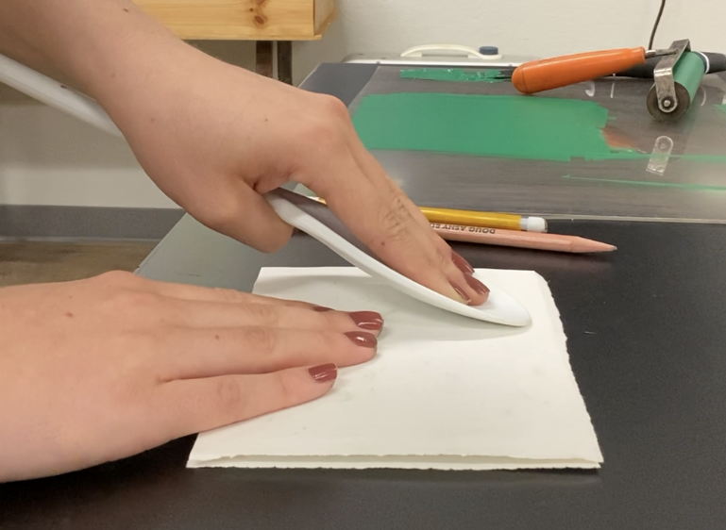
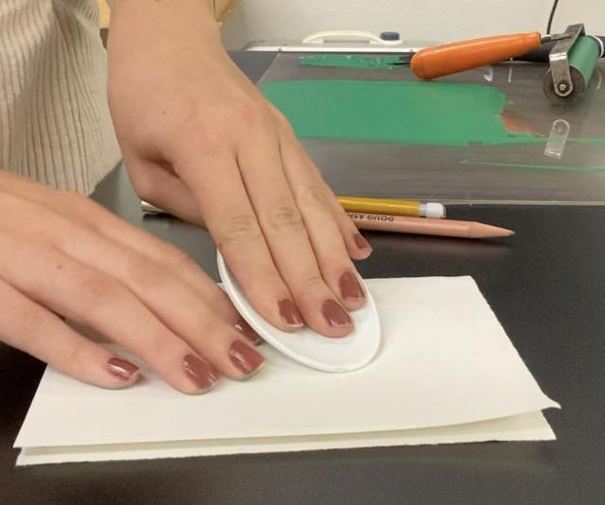
Process
13. Holding paper still, rub a spoon over the entire surface of what will be printed.
Hold the spoon firmly, choking up the handle
Apply even pressure while moving in small circular motions
Students may carefully peek at a corner of the page to see if the ink’s been evenly transferred

Slide 20
Process
14. Carefully pull back the paper that’s on top of the plate.

Slide 21
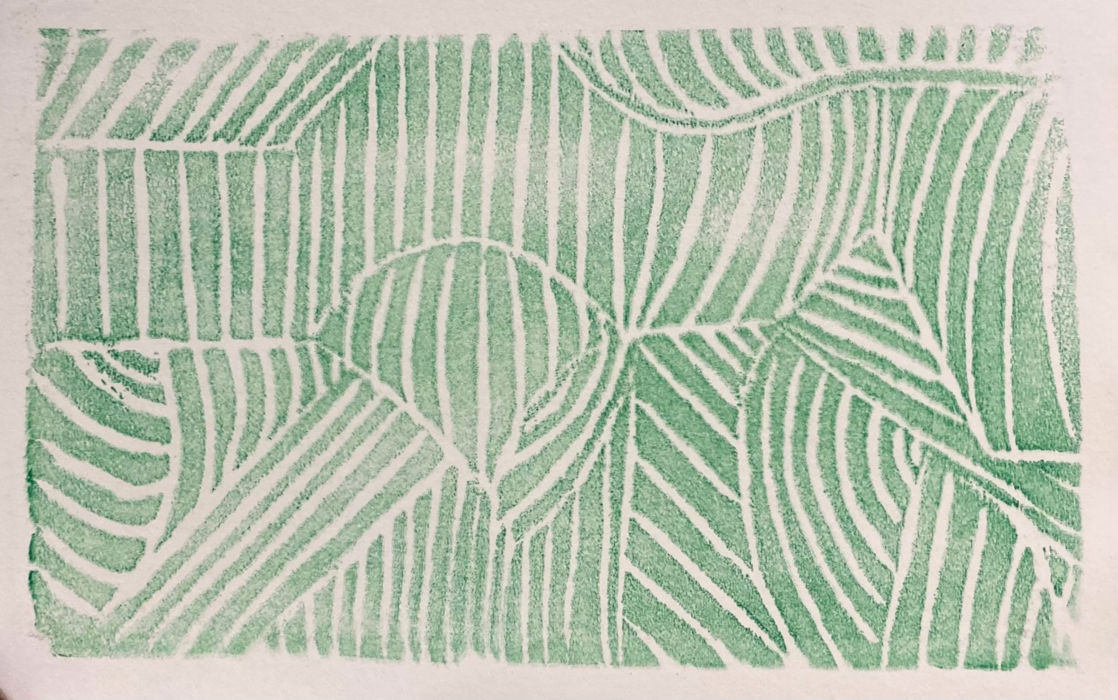
Process
Check for inconsistencies in the print made.
inconsistent
consistent

Slide 22
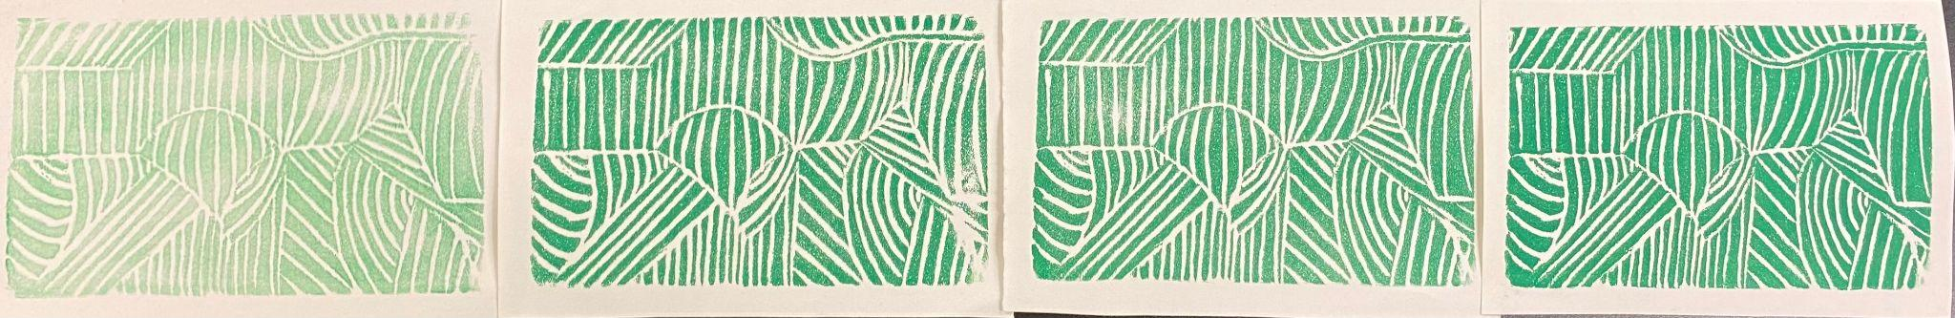
Process
The first print is not going to be perfect, so repeat steps until satisfied!
If choosing the styrofoam option, students may only be able to print once or twice before it gets pressed down & won’t be able to print clean lines anymore.
Linoleum can hold together for a much longer time.

Slide 23
Presenting
Students will place their finished work in an area to display.
Each student will describe their piece, and their thought/printing process.
Students will be encouraged to critique and comment on each other’s prints.
Critique Questions:
Where did the student distort the perspective?
How did the student use line to show different perspectives?
What are some things the student can improve on?
What are some strengths?

Slide 24
Rubric
Objectives | Exceeds | Meets | Does Not Meet
Displays Distorted Perspective | Student implemented distorting perspective. | Student implemented distorted display, but could have pushed it further. | Student did not included distorted perspective in print.
Etching/Carving Quality | Student used the tools in a safe and effective way, and showed great mark making technique. | Student used tools safely, and could work on more thoughtful carving/etches. | Student did not use tools in a safe manner. Mark making is messy & seems rushed.
Printing Quality | All directions were followed, and ink was preplanned in a logical way with excellent consistency. No ink smudges are on the page. | All directions were followed. A few ink inconsistencies throughout the print. Only 1 ink smudge. | Methods were clearly not followed. Ink is blotchy in many areas & looks unfinished. More than one area is smudged with ink.

Slide 25
Glossary:
Foreground: the area in a composition that’s viewed as the nearest to the observer.
Midground: the area in a composition that’s viewed as in the middle of the foreground and background.
Background: the area in a composition that’s viewed as the farthest, and behind the main subject matter.
Mark making: different lines, dots, patterns, and textures created in an artwork.
Vanishing point: the point in an image that is viewed as the farthest point. This point is where all the receding lines of perspective meet.
Perspective: Drawing in a way that 3-D objects on a 2-D plane give the impression of depth and position in relation to each other.

Slide 26
Glossary:
Distorted perspective: Warping subject matter, and making the composition so that it looks significantly different from what it would normally.
Abstract landscape: Altering an existing scene in real life, and distorting it to become more abstract than realistic.
Realism: Making art that represents what the real world looks like.
Brayer: a hand-tool used to roll and spread ink out onto the inkpad, and roll the ink onto the plate of material that’s been carved into in order to be printed.
Inkpad: a piece of material that has ink rolled out onto it in order for the brayer to charge.
Charge: have enough ink applied to be able to transfer onto carved plates evenly.

Slide 27
Glossary:
Line: a recognizable path created by a point moving in space
Horizon Line: a line describing where the land meeting the sky, always at eye-level
Etching: creating marks or scratches into styrofoam
Linocut: a printmaking process in which relief carving is done on a block of linoleum.
Linocut tool: a tool used specifically for carving into linoleum
Gouge: the different sizes of the carving tips
Edition: a print that can be recreated
Registration: marking the place of the plate on a paper underneath so that the edition can be printed multiple times in the same spot.
Pull: lifting paper from inked plate

Slide 28
Sources
Images:
https://images.ctfassets.net/f1fikihmjtrp/7CHdmBBq84gkdqKWpD0KHe/05500b1e6f8c86dce2cef3e1707c2a01/40203-1009-2-3ww-l.jpg.
http://www.tworedroses.com/newsletters/newsletter06302017.html
https://wildfloweringsarttutorials.blog/2011/10/20/carving-linoblocks-carving-boards-safety-tips/
https://www.hobbycraft.co.uk/ideas/art/how-to-create-a-dual-colour-linocut-print
https://www.scasd.org/Page/29684
Information:

